Slide 1


Slide 2
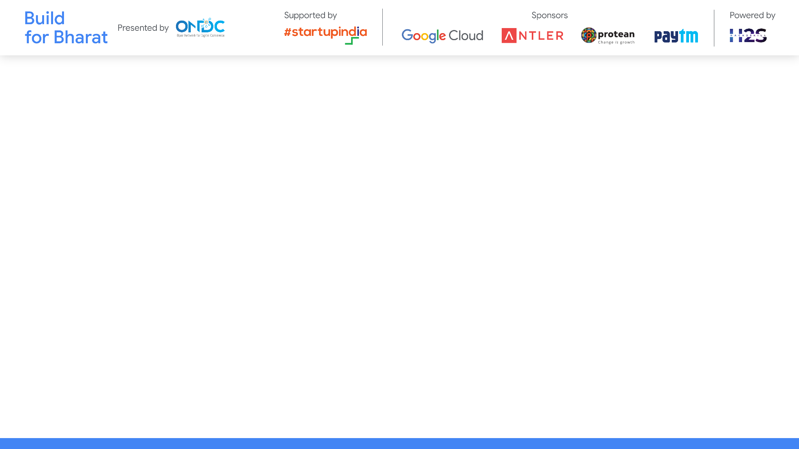
Team Name: Ghostpye
Team Leader Name: Shantanu Nimkar
Team Member Names: Sameer Borkar
Problem Statement Category: Foundational or Scalable Solution
Problem Statement: Catalog digitization
*You can make a copy of the slides. Do not change the template branding.

Slide 3
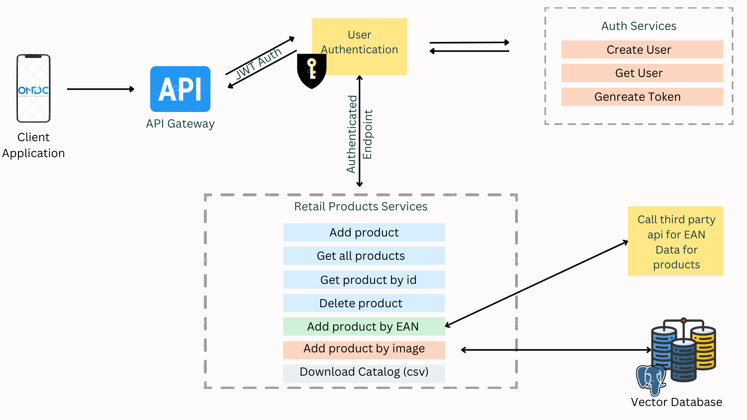
Architecture & Design

Slide 4
Architecture & Design for the innovative solution.
Modular architecture that provides flexible integration options.
Tech evaluation would include the following
Reusability - of APIs, algorithms, data sets
Extensibility - to other use-cases
Scalability - working at population scale with optimal capacity & minimal latency
Security - ensuring transactional guarantees
*You can make a copy of the slides. Do not change the template branding.

Slide 5
Define customization & deployment options of your proposed solution.
*You can make a copy of the slides. Do not change the template branding.

Slide 6
Test cases & data (as applicable) against which the eval criteria can be assessed
*You can make a copy of the slides. Do not change the template branding.

Slide 7
Demonstrate working of the solution to the evaluation team
*You can make a copy of the slides. Do not change the template branding.

Slide 8
Important Links:-
GitHub Public Repository Link
Link to test cases and data files
*You can make a copy of the slides. Do not change the template branding.

Slide 9


